Slide 1
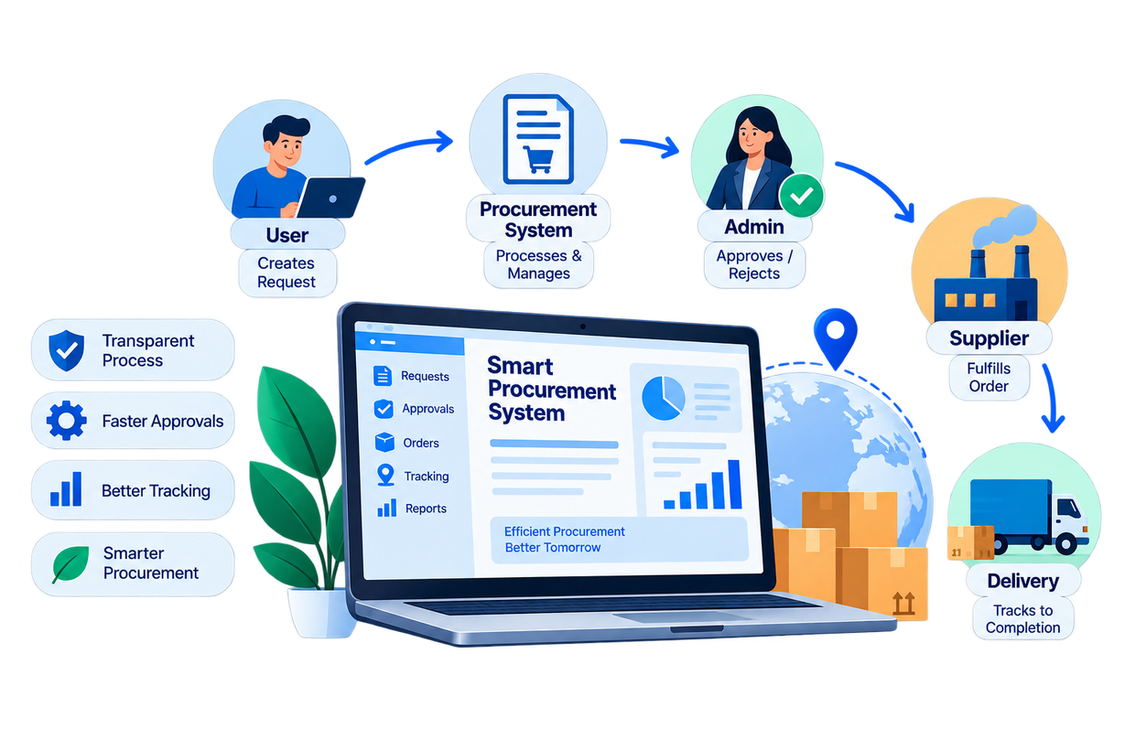

PROJECT TITLE:
Smart Procurement & Purchase Order Management System

Slide 2

Project Overview
The Smart Procurement & Purchase Order Management System is a web-based application designed to digitize the procurement lifecycle.
What does it manage?
Request:
Users create requests for required products.
Approval:
Administrators purchase,review and approve/reject requests.
Fulfillment:
Suppliers manage assigned products, inventory and shipments.
Tracking:
Users and administrators can monitor order progress and delivery status.
One platform connecting Users, Administrators and Suppliers.

Slide 3

Introduction
The Smart Procurement & Purchase Order Management System is a web-based platform that digitizes and streamlines the procurement process from purchase request to delivery.
User
Admin
Supplier
Creates purchase requests, views products, monitors orders and tracks deliveries.
Reviews requests, manages approvals, handles payments and monitors order progress.
Manages inventory, fulfills approved orders and updates shipping information.

Slide 4
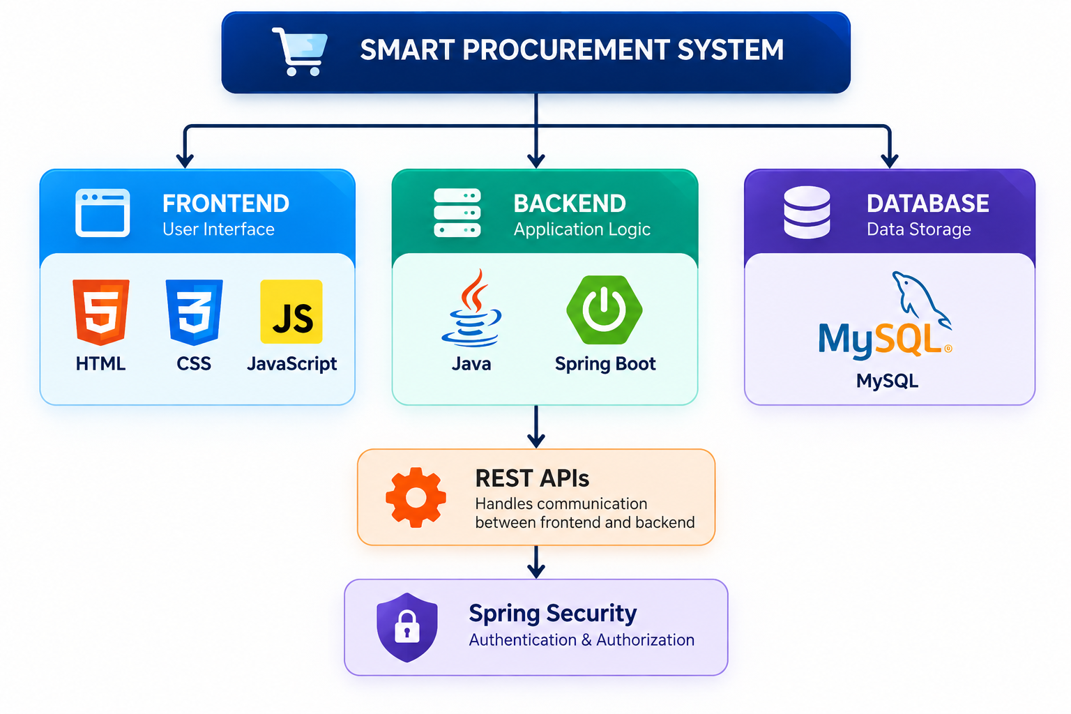
Technology Stack

Slide 5
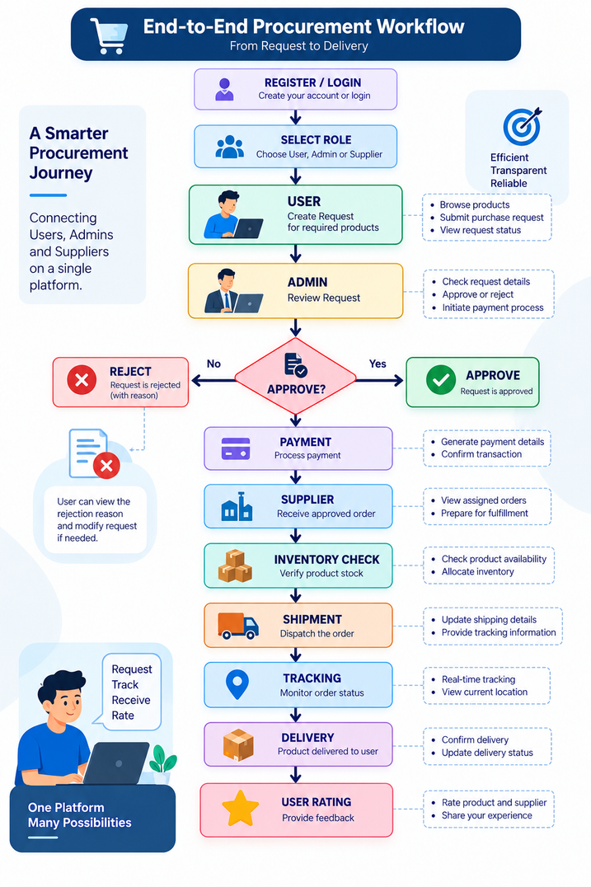
++

Slide 6
Login & Authentication
Secure entry point to the Smart Procurement System
1. Enter Credentials
Users enter their registered email address and password to access the system.
2. Validate Login
The system checks the entered credentials before processing the login request.
3. Backend Verification
The credentials are sent to the Spring Boot backend through the /api/auth/login REST API.
4. Secure Authentication
The backend verifies the user and checks the password using BCrypt password verification.
5. Role-Based Access
After successful login, the user's details and role are stored in the session, and the user is directed to the Role Selection page.
Login → Validation → REST API → Authentication → Role Selection

Slide 7
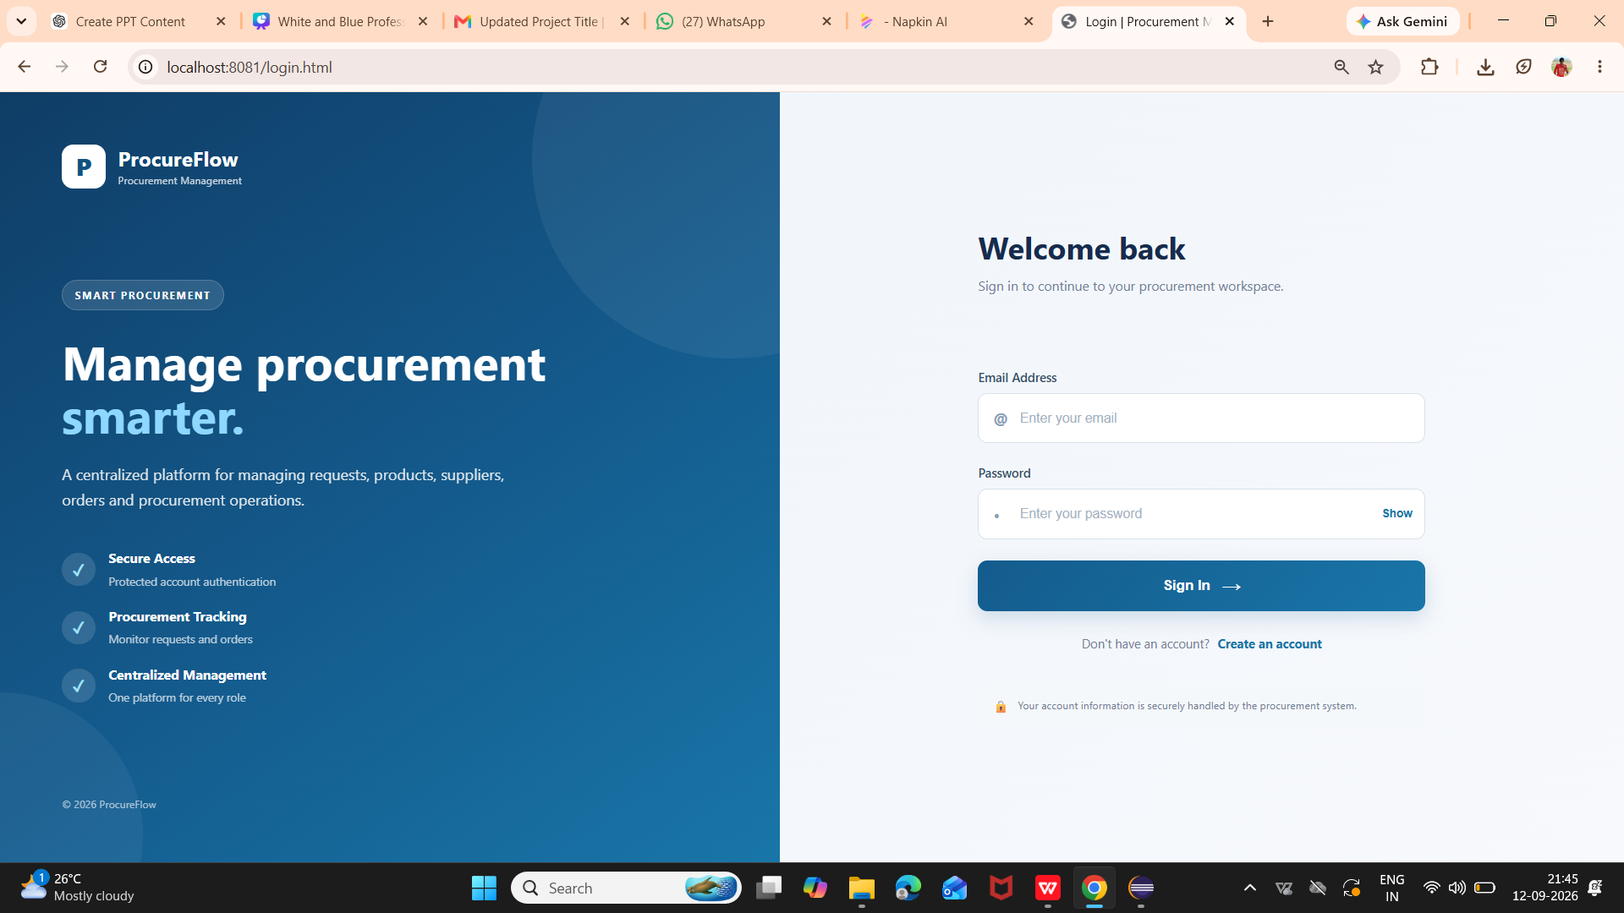


Slide 8
USER DASHBOARD —FRONTEND & BACKEND
Frontend:
•Displays a personalized User Dashboard after successful login.
• Shows key statistics: Total Requests, Pending, Approved and Orders.
• Displays the user's recent procurement requests and their current status.
• Provides quick access to New Request, Order Tracking and Downloads.
Backend Integration:
• The frontend identifies the currently logged-in user using the User ID.
• JavaScript sends a GET REST API request to the Spring Boot backend.
• API endpoint: /api/requests/user/{userId}
• Spring Boot retrieves the procurement requests associated with that user.
• The backend response is returned as JSON data.
LOGIN → USER ID → REST API → SPRING BOOT → DATABASE → JSON RESPONSE → DASHBOARD

Slide 9
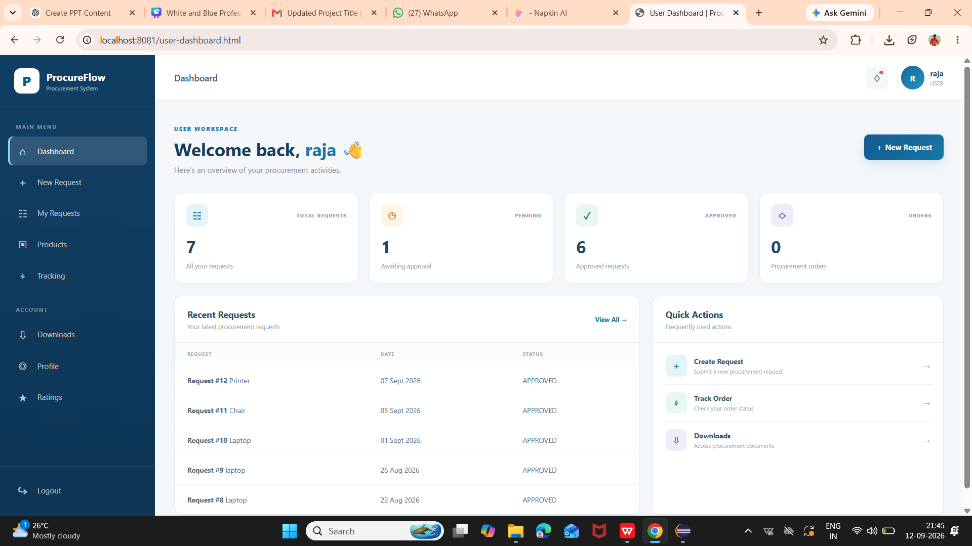

Slide 10
ADMIN DASHBOARD — FRONTEND & BACKEND
Frontend:
• Displays key procurement statistics such as Total Requests, Pending, Approved and Paid Orders.
• Shows pending requests that require administrative action.
• Provides access to Requests, Products, Payments, Tracking and Ratings.
• Includes quick actions to Review Requests, View Products and Process Payments.
Backend Integration:
• Retrieves procurement data from the Spring Boot backend through REST APIs.
• Loads and processes user requests, product information and payment-related data.
• Allows the administrator to review, approve or reject procurement requests.
• Supports payment processing for approved requests.
• Provides backend support for order/shipment tracking, allowing administrators to monitor procurement progress.
ADMIN LOGIN → ADMIN DASHBOARD → REST API → SPRING BOOT → DATABASE → RESPONSE → DASHBOARD

Slide 11
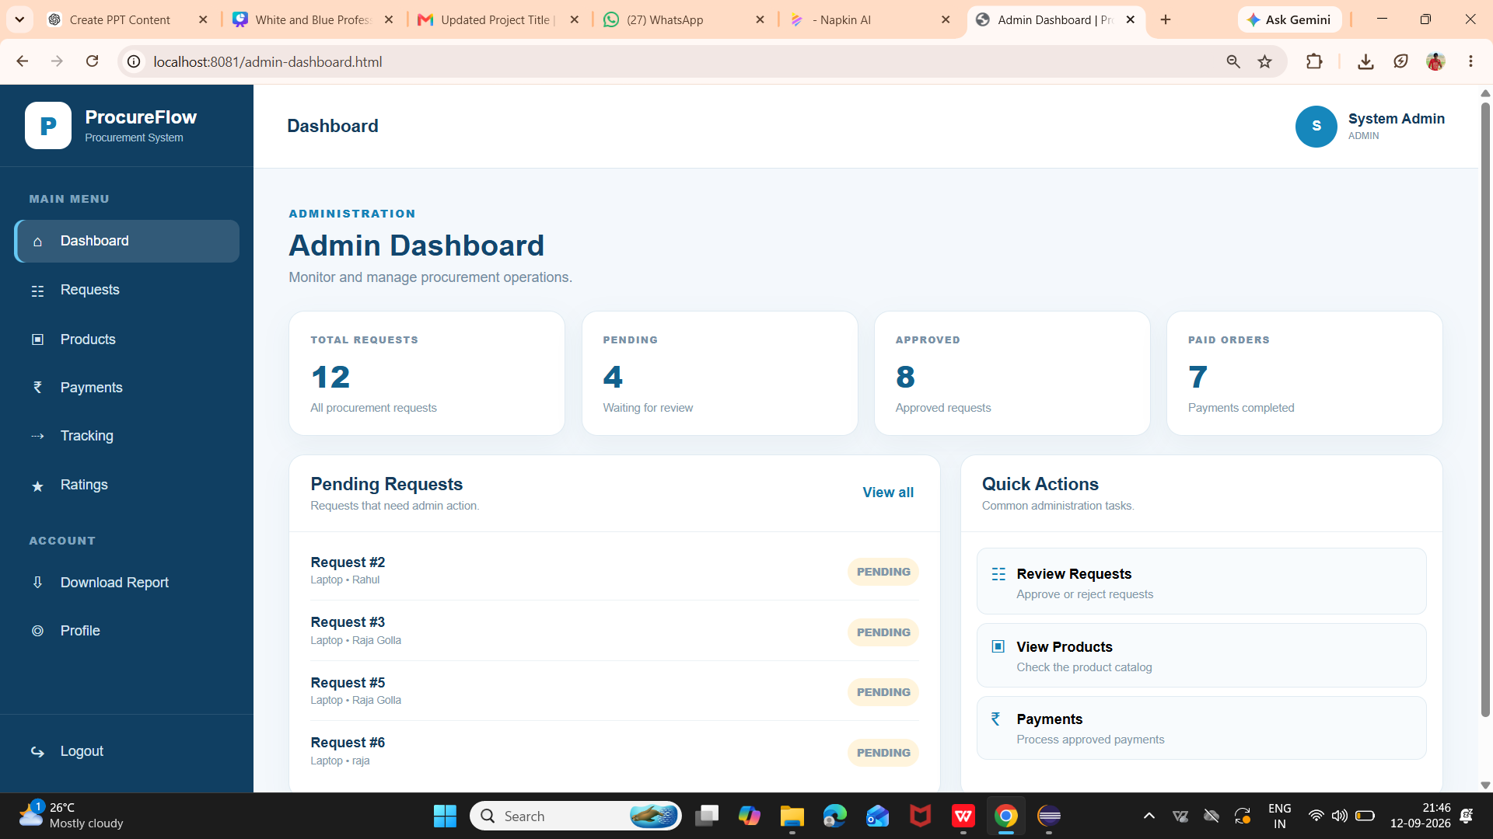

Slide 12
SUPPLIER DASHBOARD — FRONTEND & BACKEND
Frontend:
• Displays supplier information and the assigned product and available stock.
• Shows important order statistics such as Paid Orders, New Orders, In Transit and Delivered.
• Provides access to Orders, Shipping, Inventory, Ratings and Profile.
• Displays recent paid orders assigned to the supplier.
• Provides a Shipping Progress section to monitor delivery activities.
Backend Integration:
• Retrieves the supplier's assigned orders and product information from the Spring Boot backend.
• Connects supplier actions with backend APIs for orders, inventory and shipping.
• Allows suppliers to update inventory and shipment/delivery status.
• The backend processes these updates and stores the latest information for the procurement workflow.
SUPPLIER LOGIN → SUPPLIER DASHBOARD → REST API → SPRING BOOT → DATABASE → RESPONSE → DASHBOARD

Slide 13
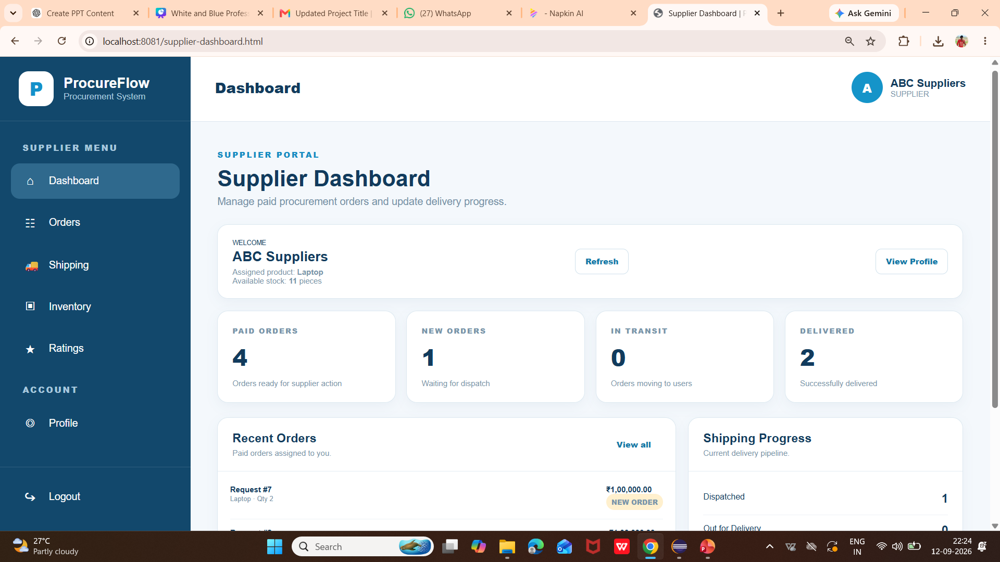

Slide 14
THANK YOU!

